Slide 1




Dani Siaj
Business Analysis on Heart Attack Risk Prediction

Slide 2
Dataset
Context:
Heart attacks, or myocardial infarctions, continue to be a significant global health issue, necessitating a deeper comprehension of their precursors and potential mitigating factors
Content:
Comprehensive array of features relevant to heart health and lifestyle choices, encompassing patient-specific details such as age, gender, cholesterol levels, blood pressure, heart rate, and indicators like diabetes, family history, smoking habits, obesity, and alcohol consumption. Additionally, lifestyle factors like exercise hours, dietary habits, stress levels, and sedentary hours are included. Medical aspects comprising previous heart problems, medication usage, and triglyceride levels are considered. Socioeconomic aspects such as income and geographical attributes like country, continent, and hemisphere are incorporated.
Acknowledge:
This dataset is a synthetic creation generated using ChatGPT to simulate a realistic experience.

Slide 3
Exploratory Data Analysis
Original shape of Database: 8673 Rows, 26 Columns
Final Shape: 8673 Rows, 28 Columns
Discoveries
Dataset Clean: No missing or duplicated values
Min(“Age”) = 18. No data on children
Some columns values are 0 for No, 1 for Yes. Missing detailed information (e.g.: alcohol use)
Risk for Heart Attack is measured as Yes (0) or No (1), instead of levels of risk.
Blood Pressure is an ‘object’ data type, so no Aggregations can be performed on this column.
Modifications
Population was organized in by cohorts defined by decades (20s, 30s, 40s, 50s…)
Column ‘Blood Pressure’ was split in 2 new columns (‘Systolic’, ‘Diastolic’) and removed
Dataset was divided into 3 smaller datasets: ‘Demographics’, ‘Medical History’ and ‘Lifestyle’

Slide 4
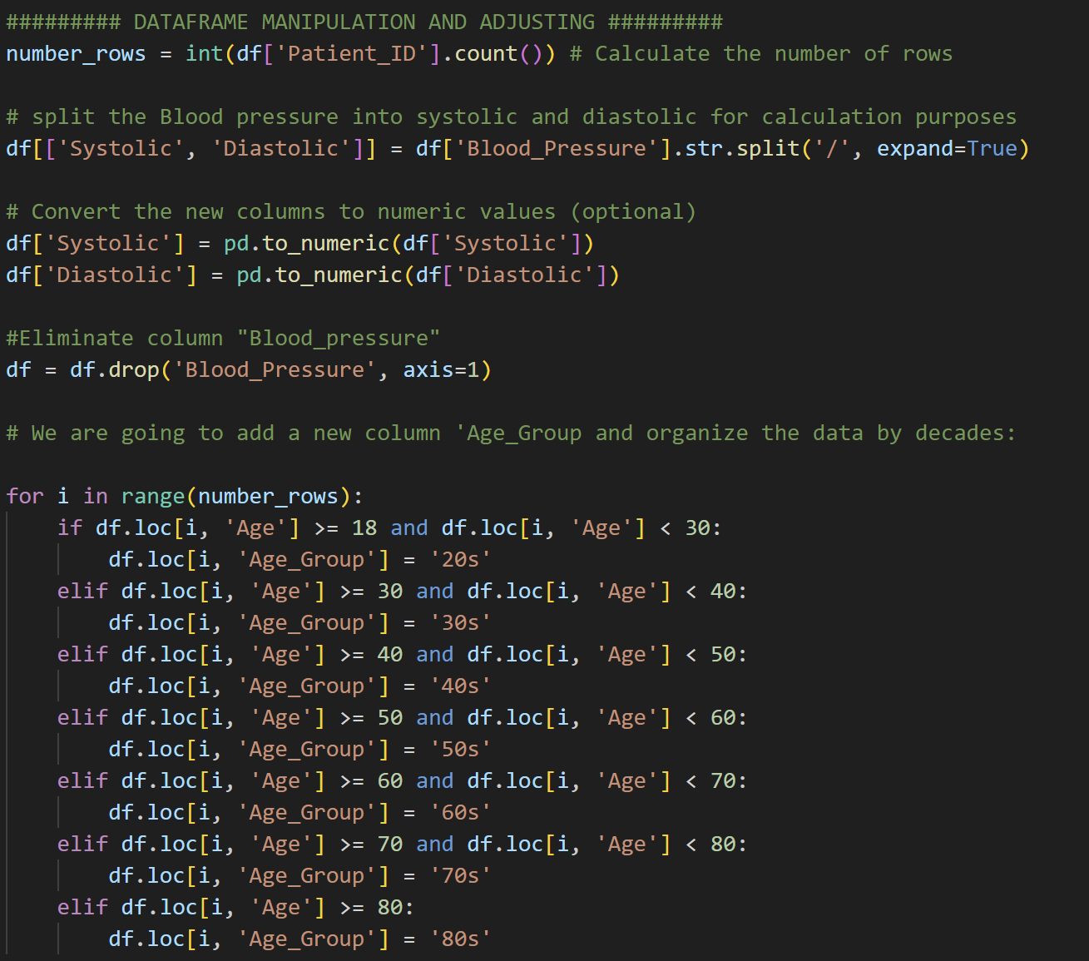
Exploratory Data Analysis

Slide 5
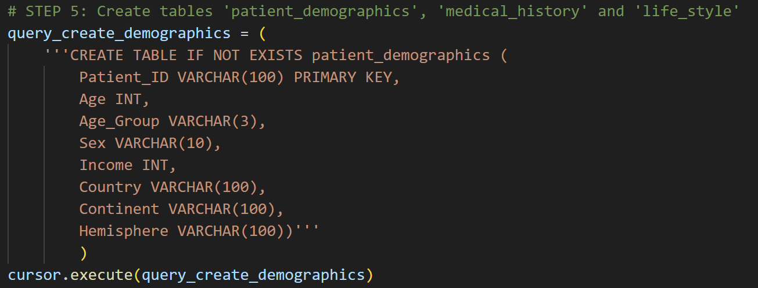
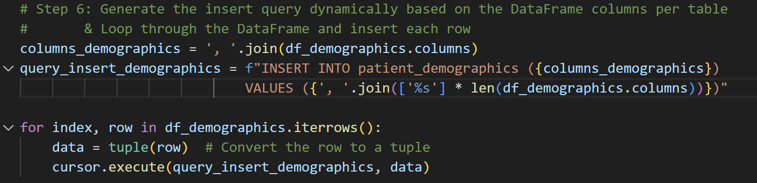
MySQL Queries

Slide 6
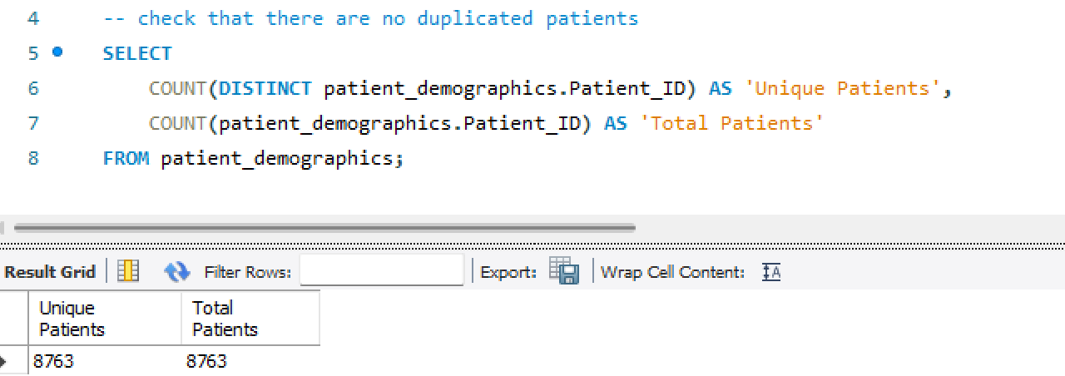
Business Analysis

Slide 7
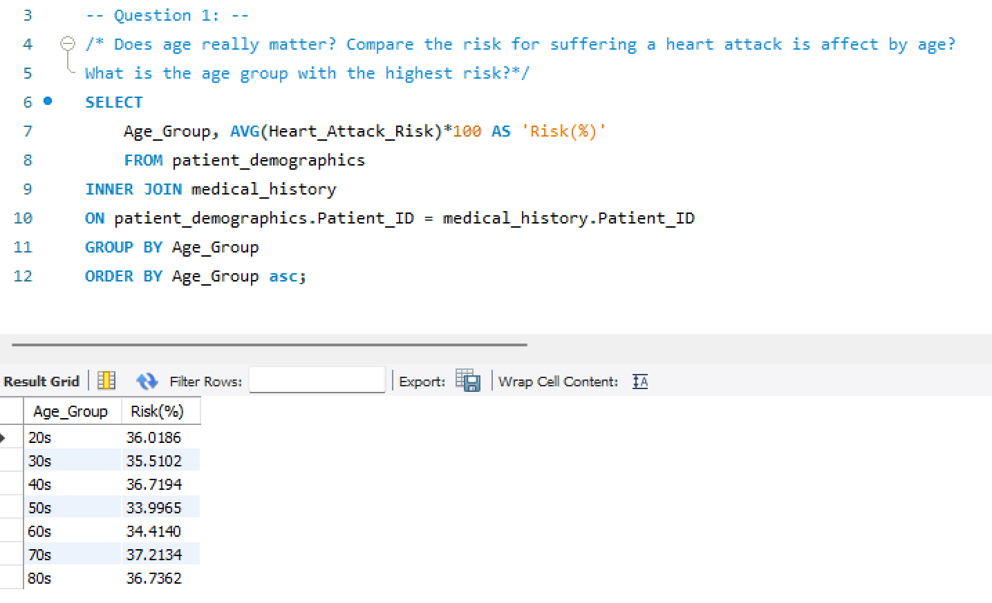
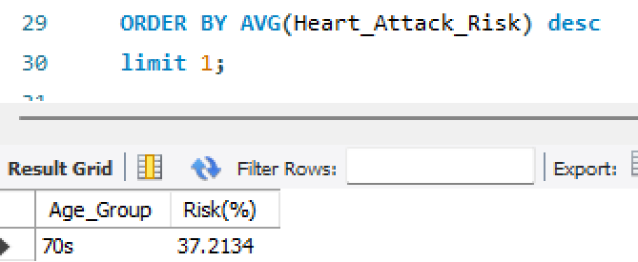
Business Analysis

Slide 8
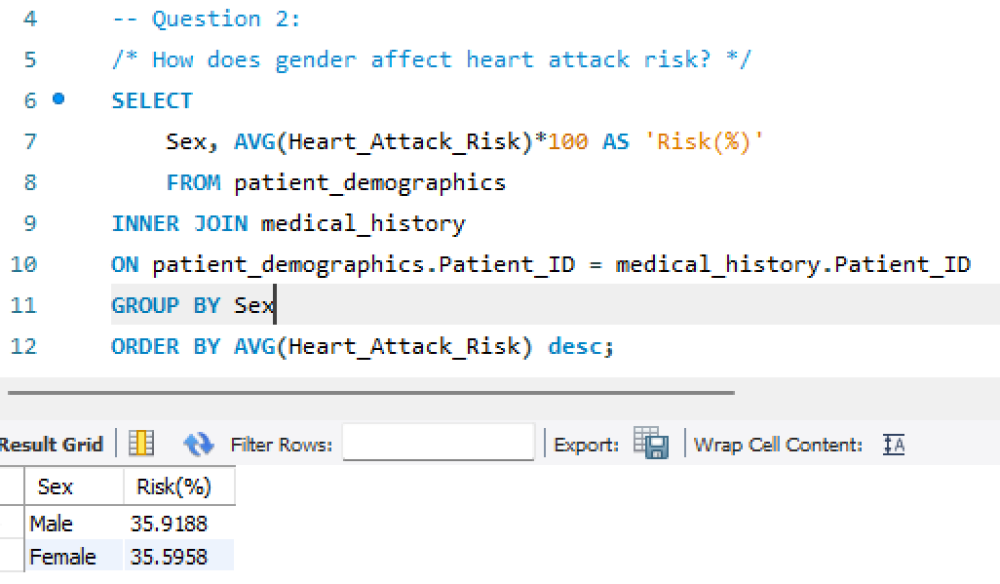
Business Analysis

Slide 9
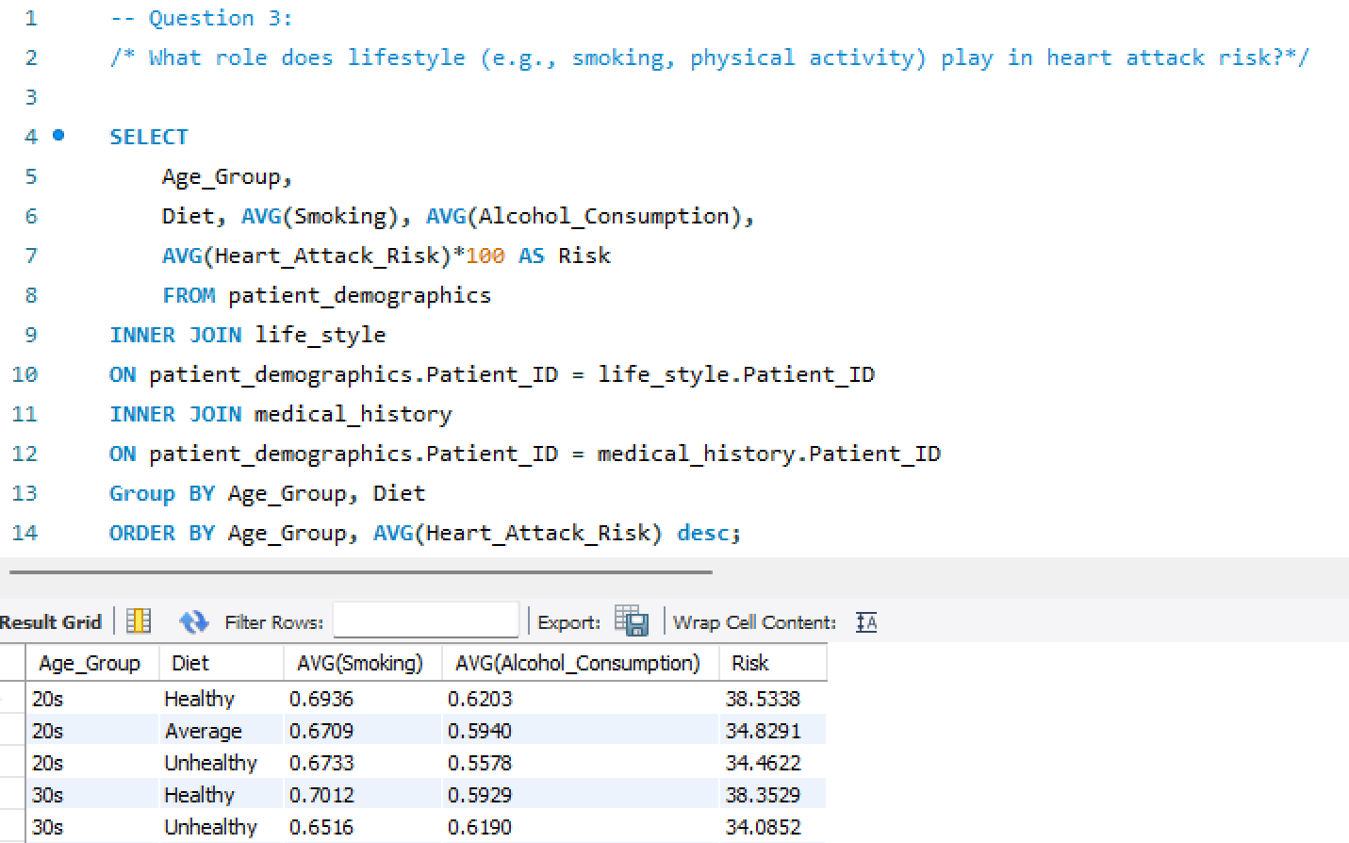
Business Analysis

Slide 10
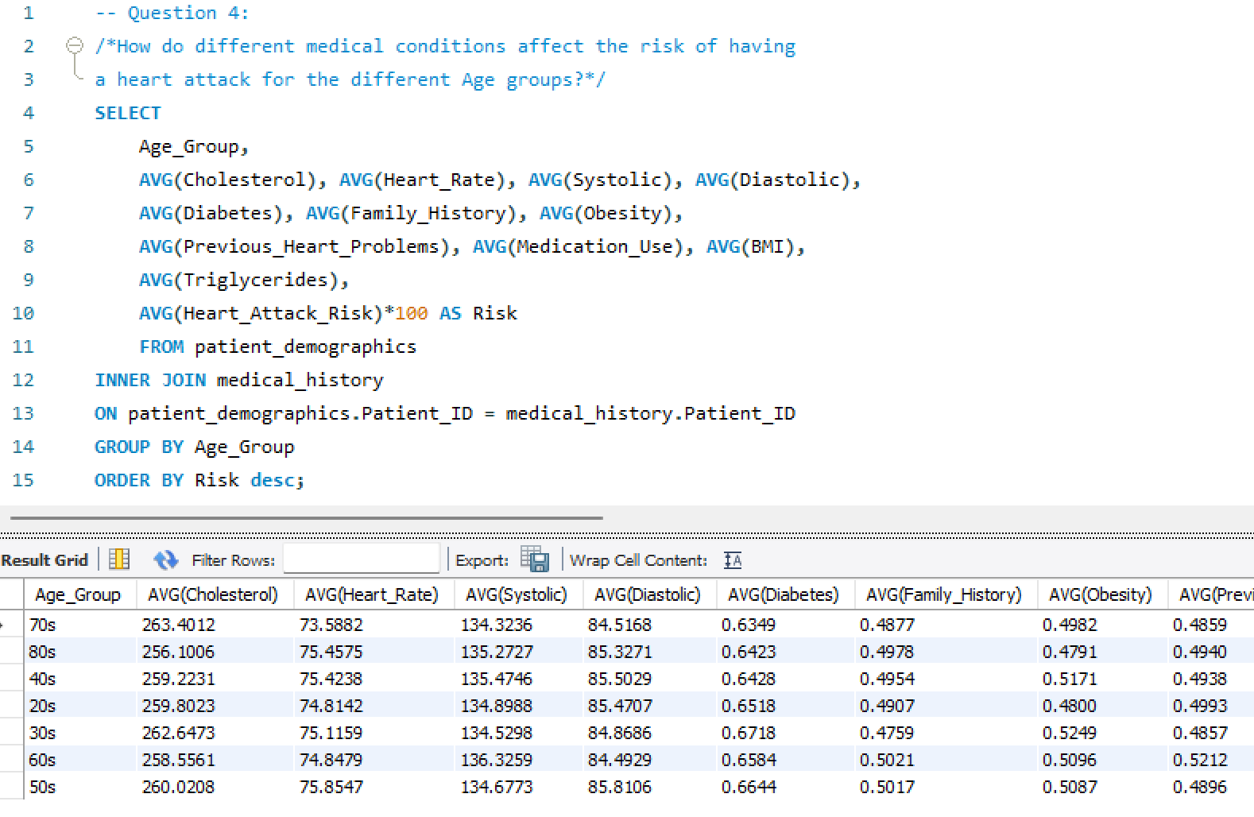
Business Analysis

Slide 11
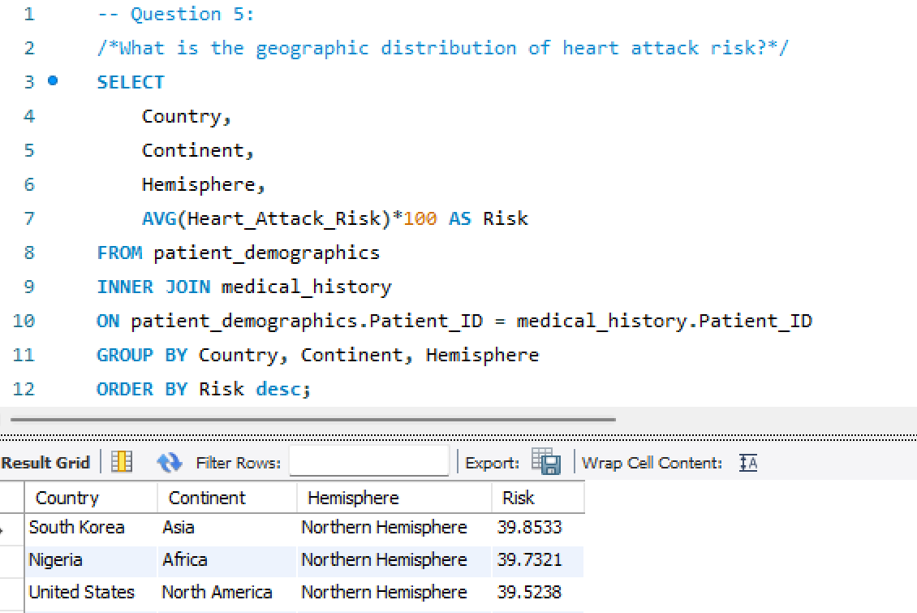
Business Analysis

Slide 12
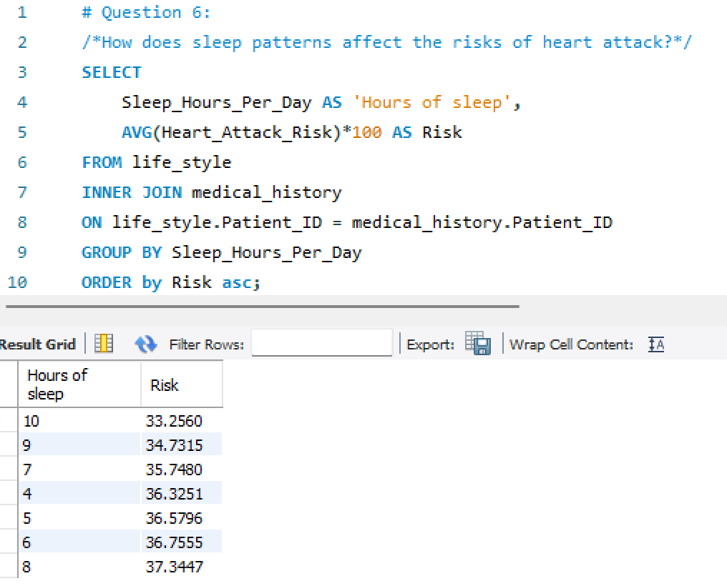
Business Analysis

Slide 13
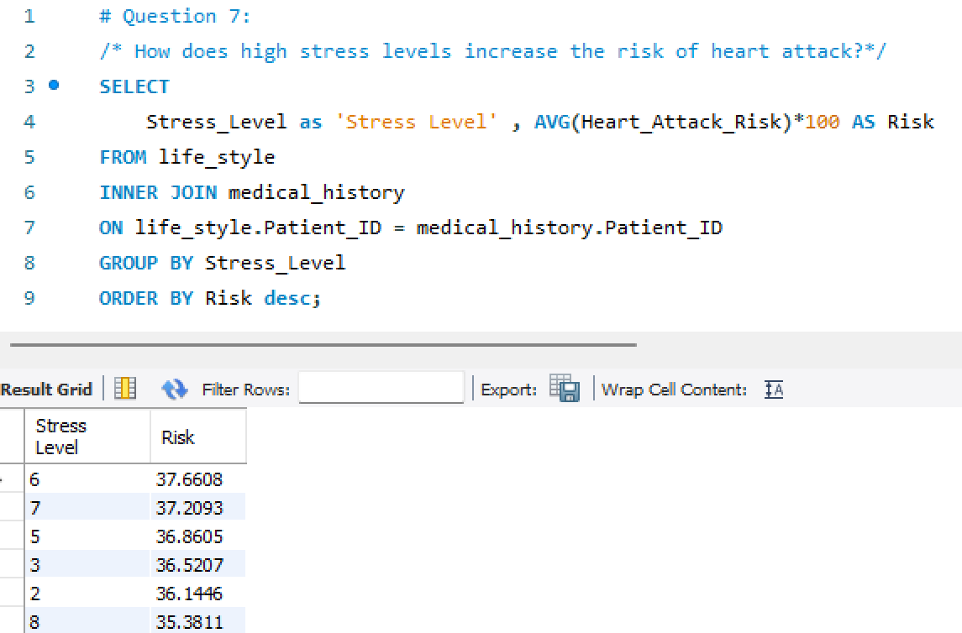
Business Analysis

Slide 14
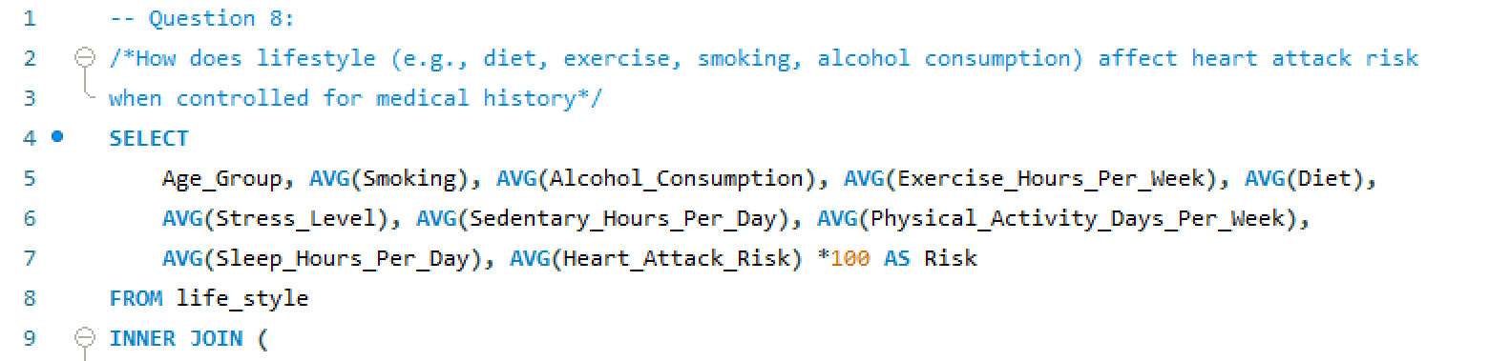
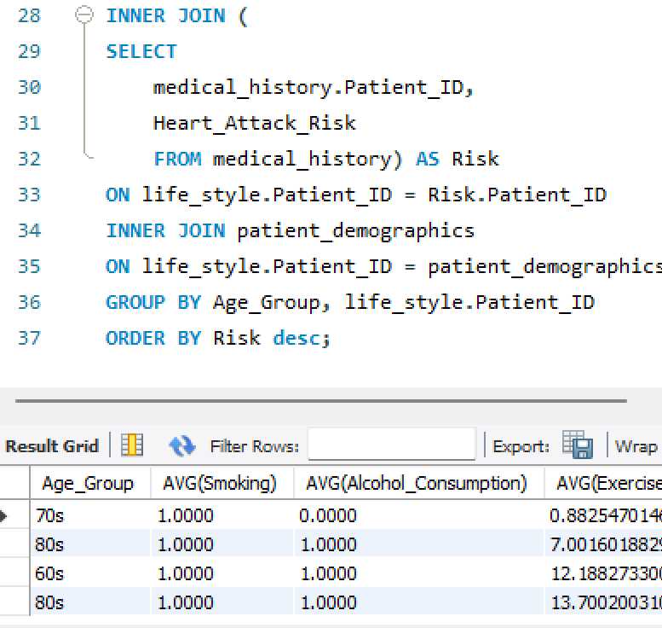
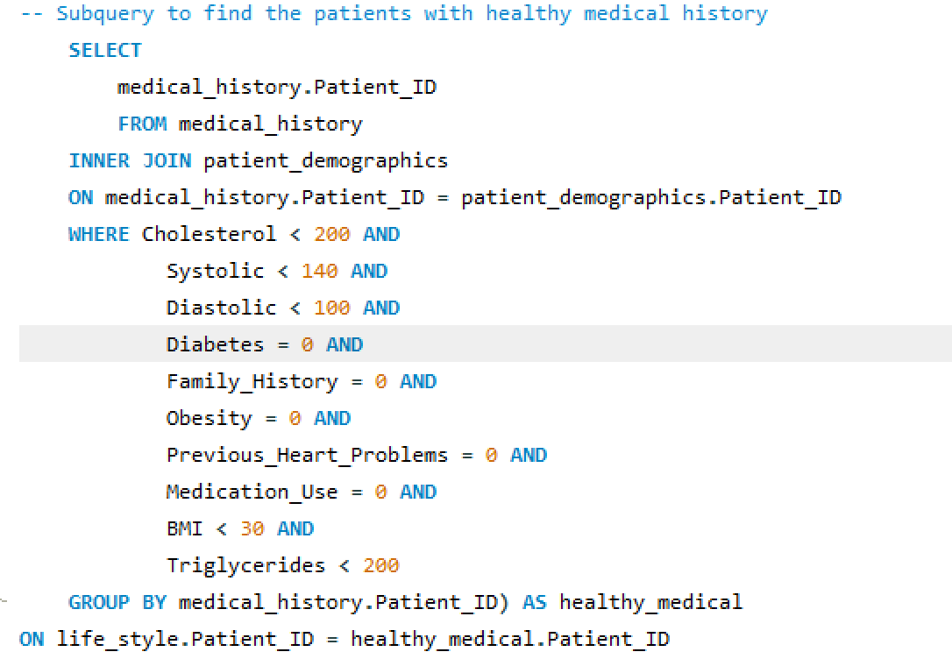
Business Analysis

Slide 15
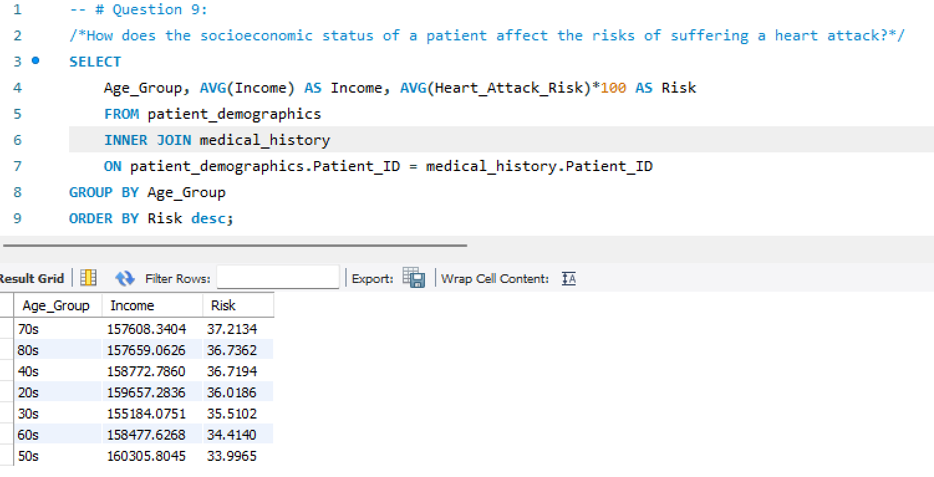
Business Analysis

Slide 16
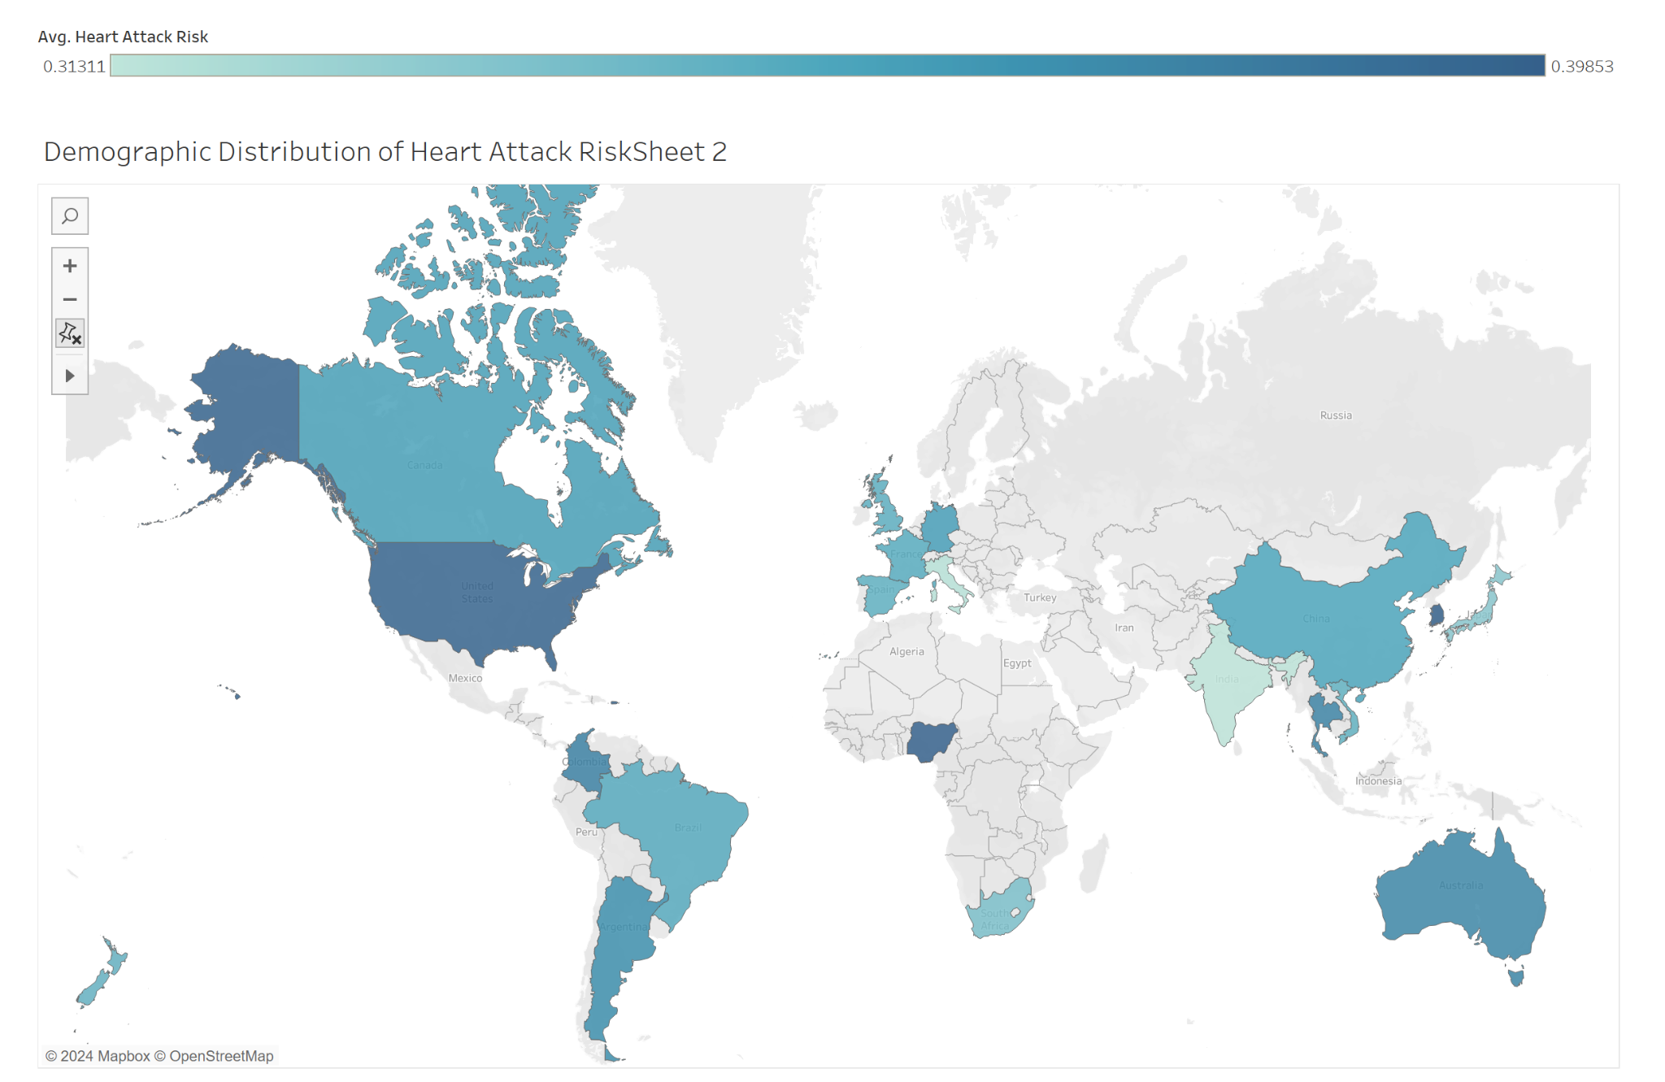

Slide 17
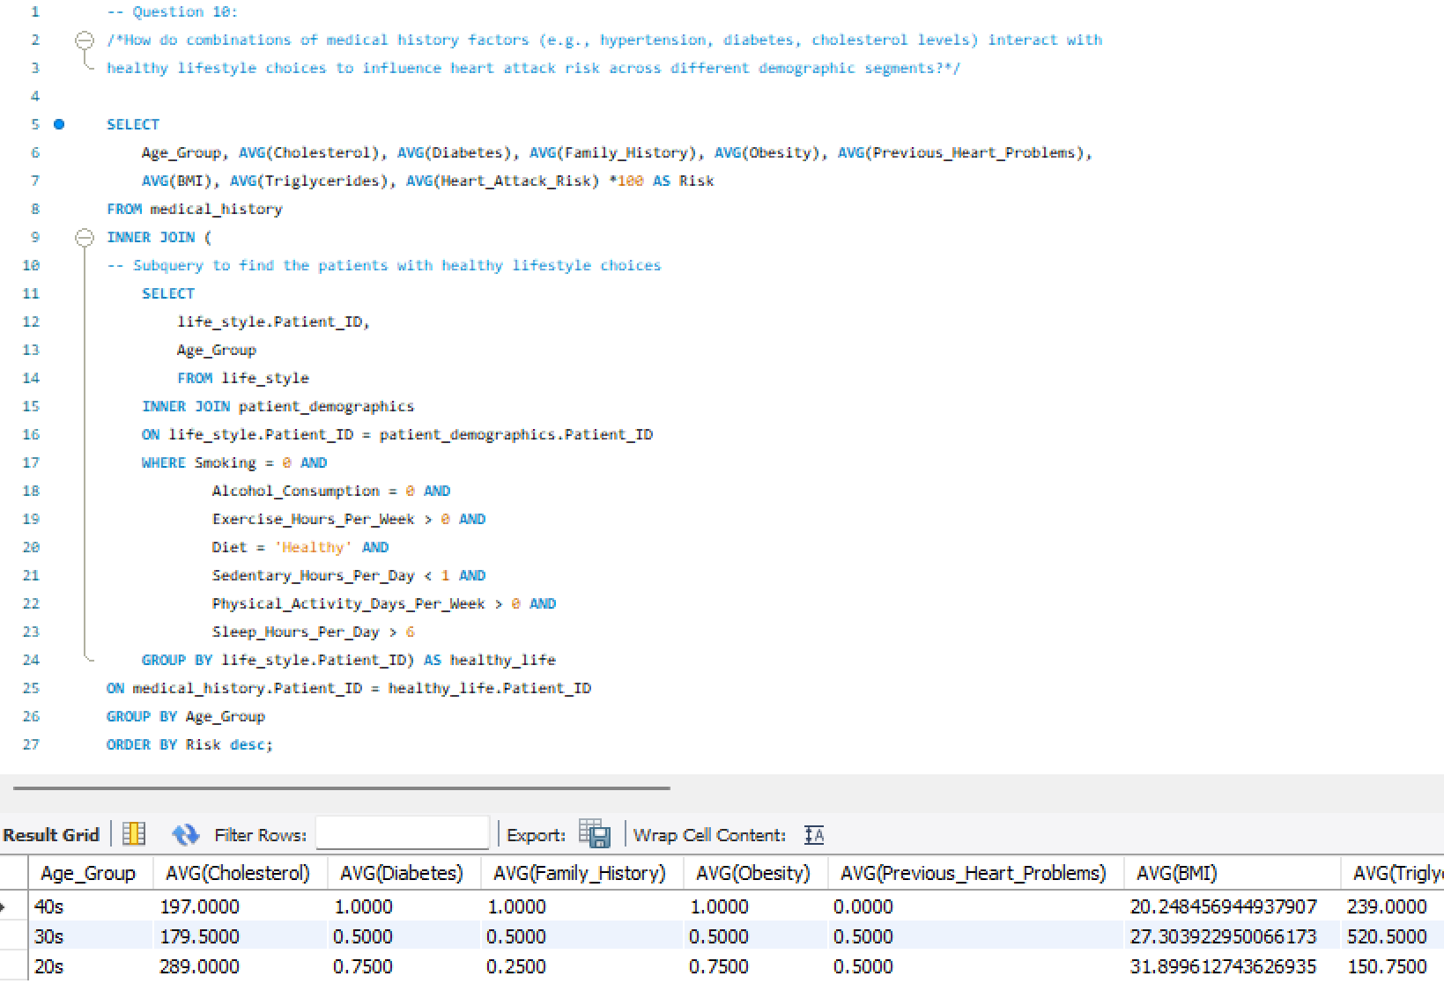
Business Analysis

Slide 18
Conclusions
Conclusion 1:
Data analysis demonstrated that data values from dataset are realistically distributed. Lack of variability along the population.
Conclusion 2:
The structure of this dataset has very large potential for accurate prediction of risk for attack along the population. However, the lack of detail in the values (0 or 1), highly limits the possibilities of our analysis.
Conclusion 3:
Although data values are very realistic, they were generated without relationship to each other.

